Slide 1
Movies website

Slide 2
Agenda
Introduction
Use Case Diagram
All Actions presented

Slide 3

Why movies? As a movie enthusiast, I often turn to films for two hours of relaxation after a long day of hard work. Much like books, movies offer a wonderful escape, allowing me to experience another person's life for a brief time.

Slide 4

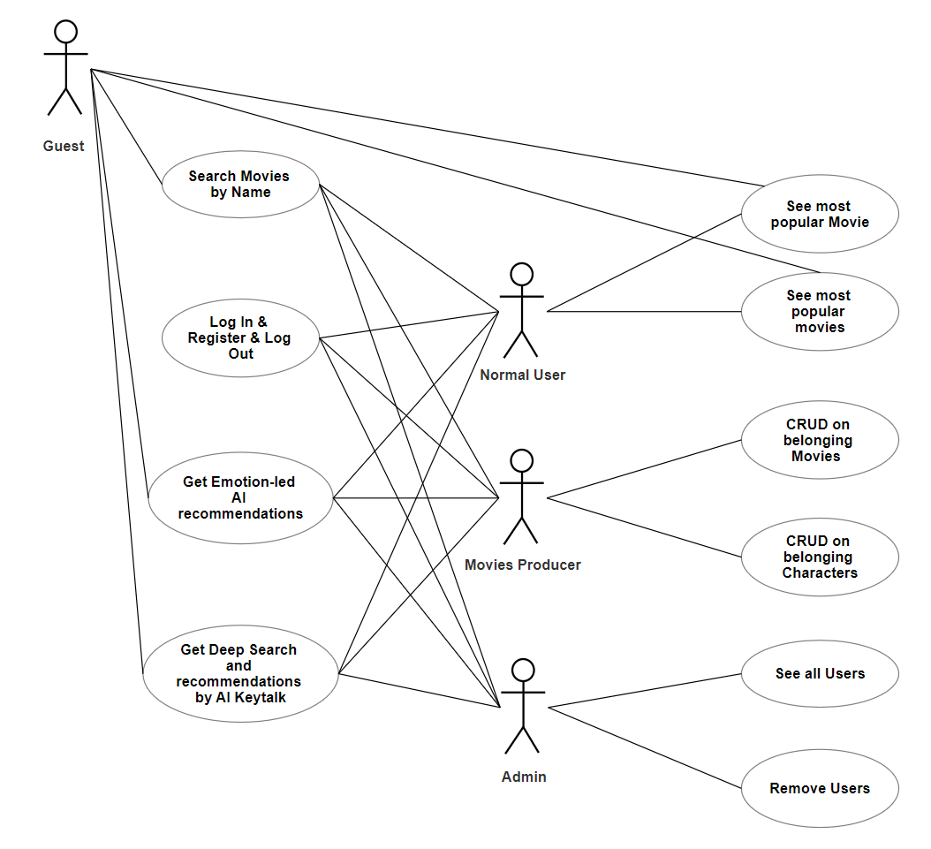
Use case diagram​

Slide 5
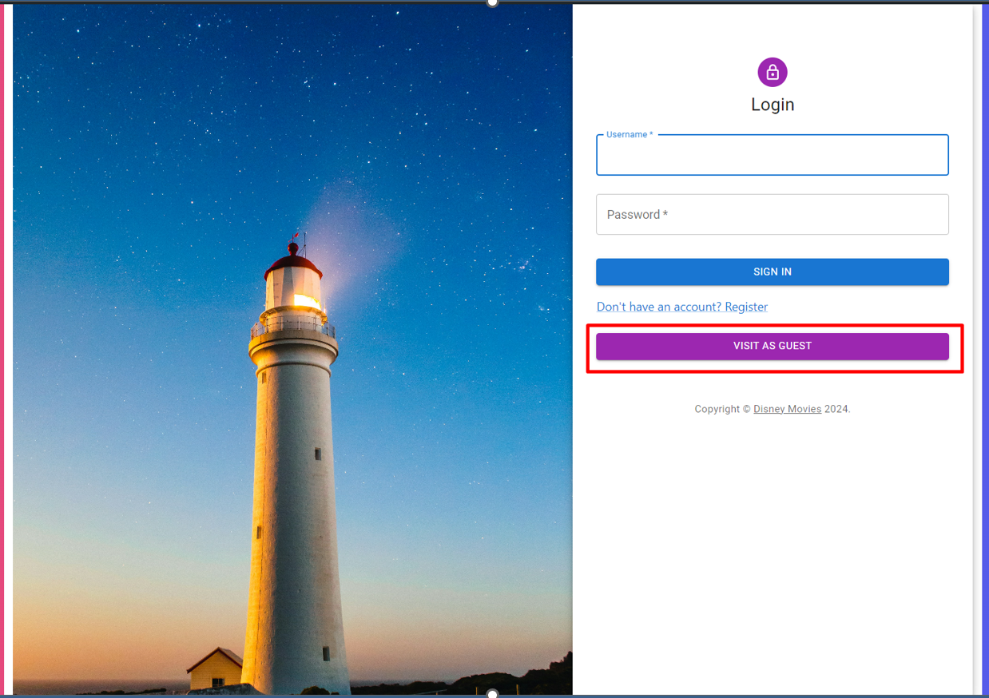
A guest’s “Log in”

Slide 6
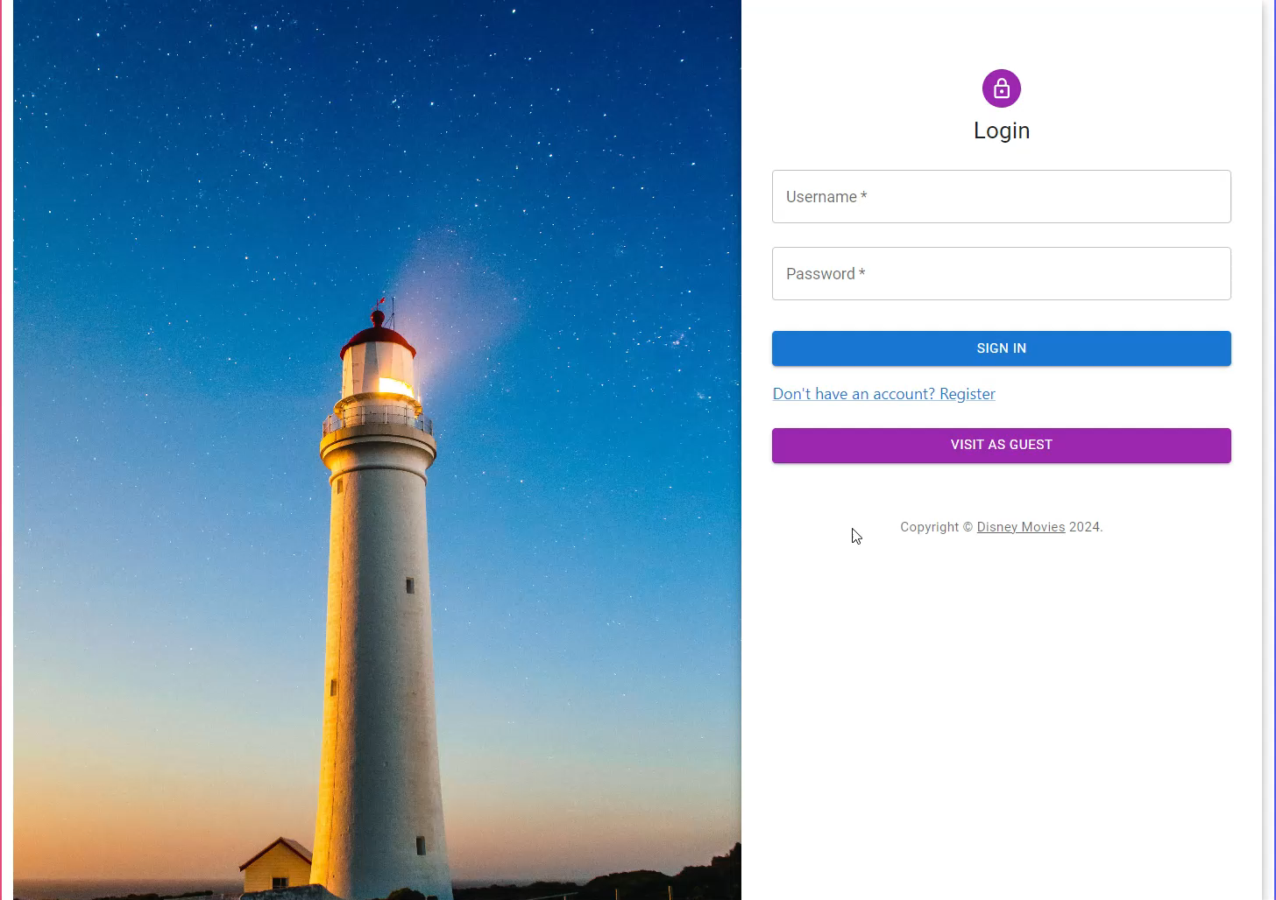
See most popular movie + search by name

Slide 7
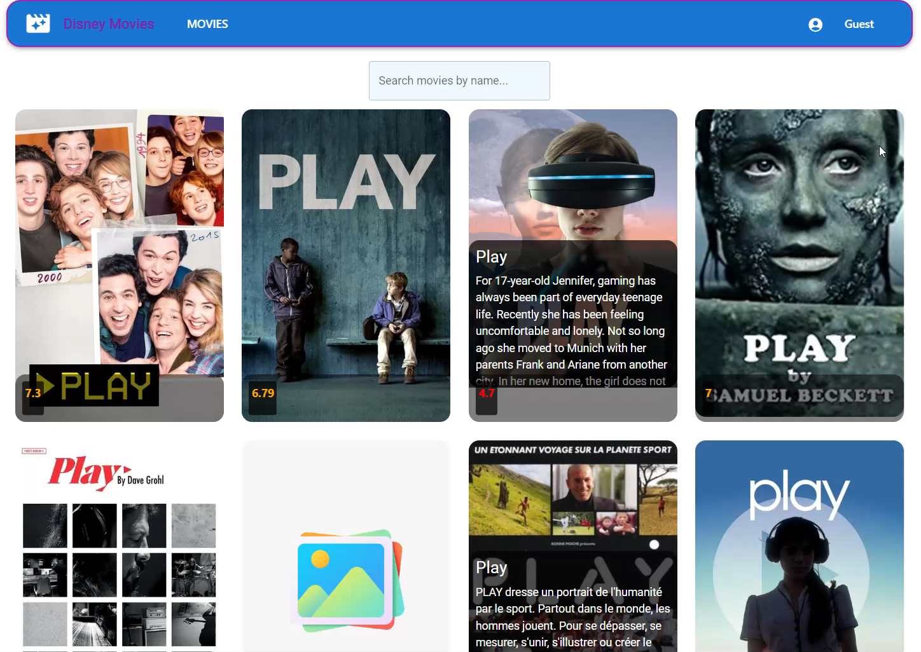
Get emotion-led Ai recommendations

Slide 8
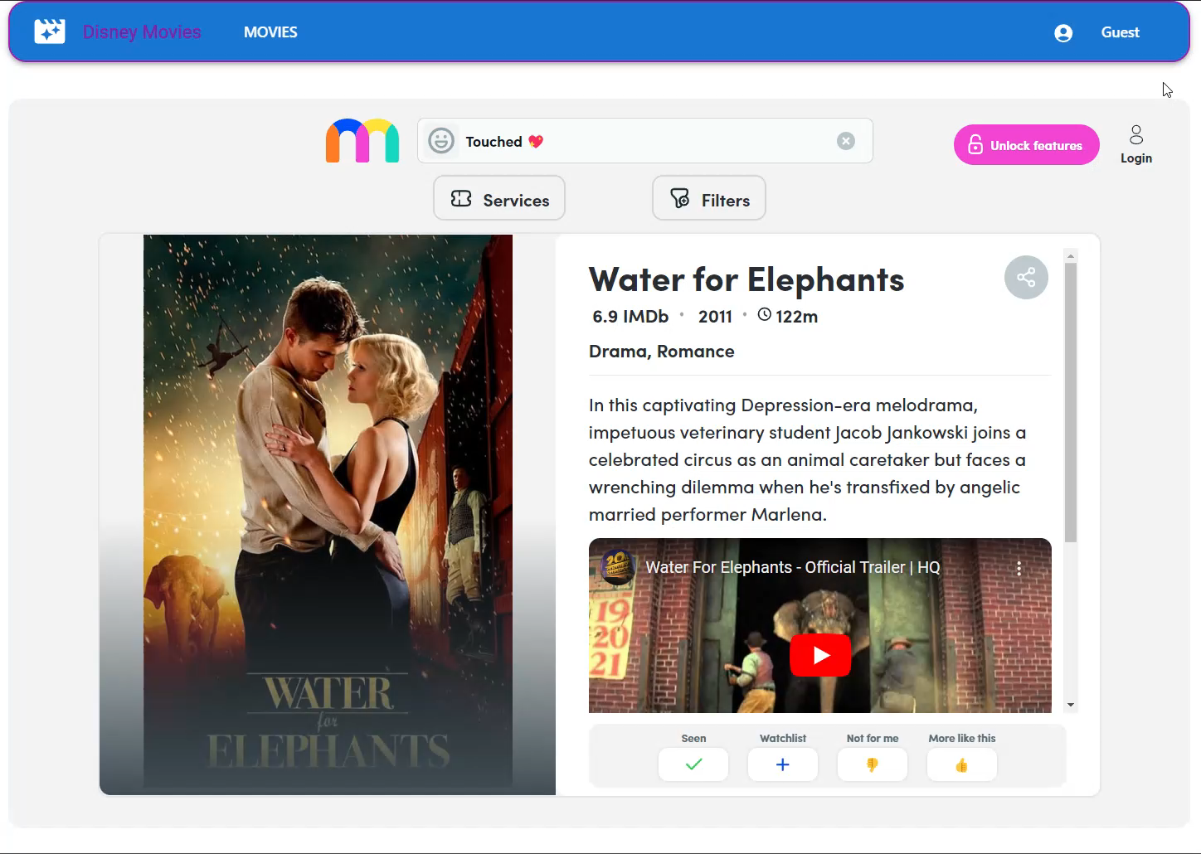
Get Deep Search and recommendations by AI Keytalk
Get Deep Search and recommendations by AI Keytalk

Slide 9
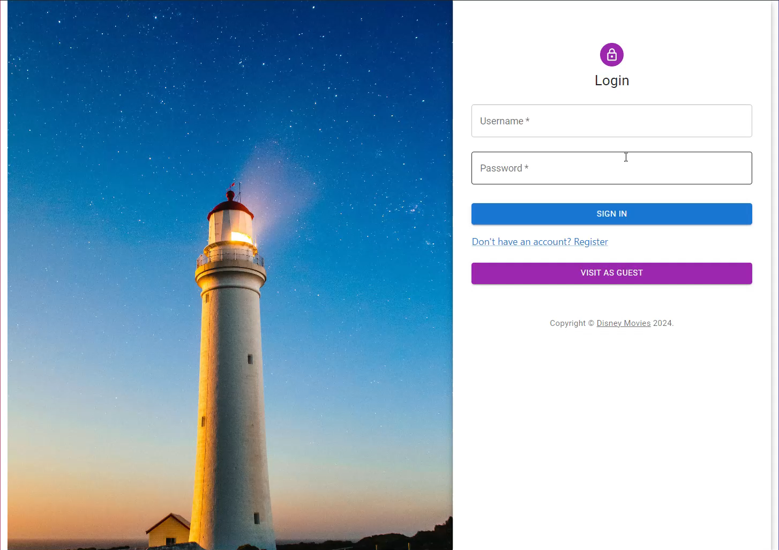
Get movie recommendations for groups
Get Deep Search and recommendations by AI Keytalk

Slide 10
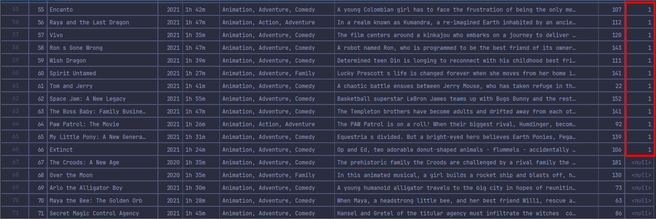
Movies Producer crud on his movies
Get Deep Search and recommendations by AI Keytalk

Slide 11
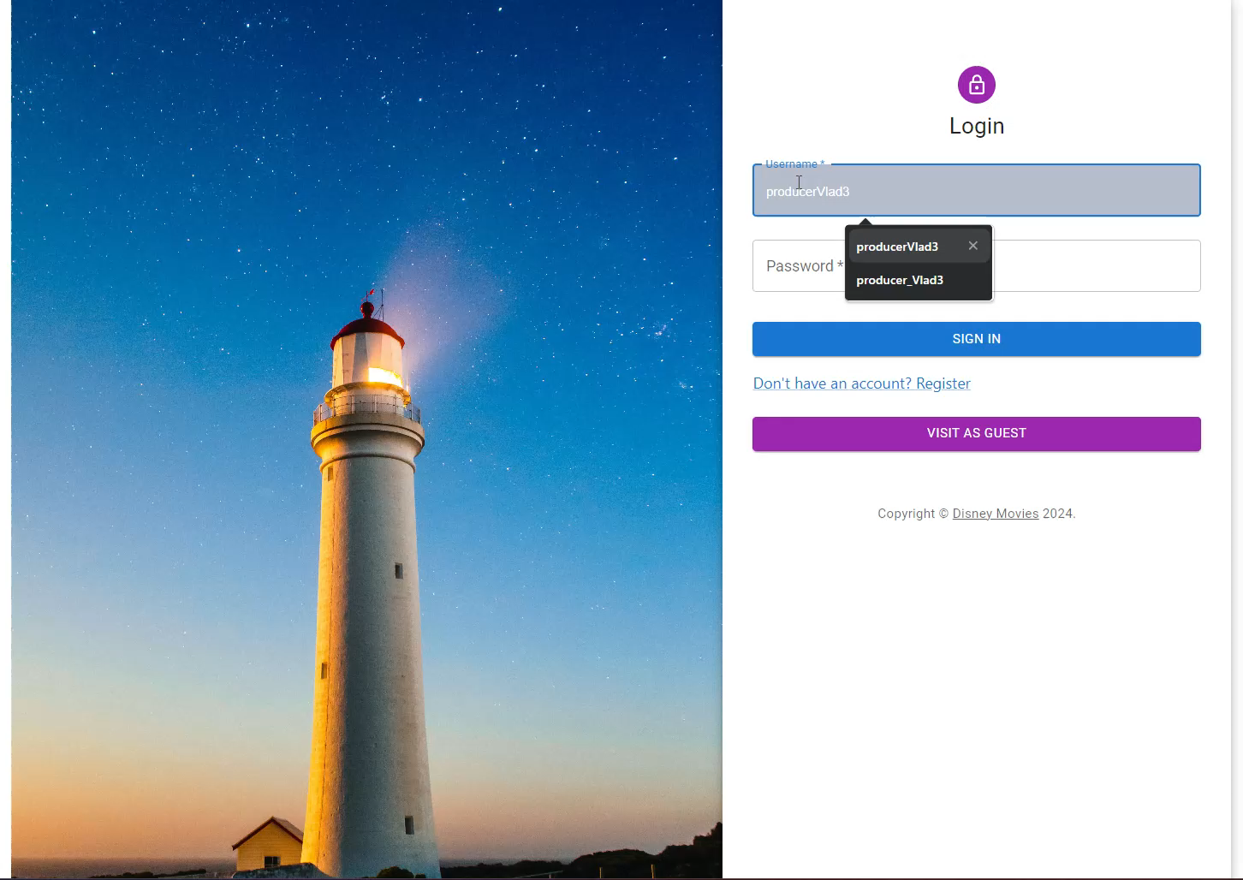
Producer Crud on movies & characters
Get Deep Search and recommendations by AI Keytalk

Slide 12
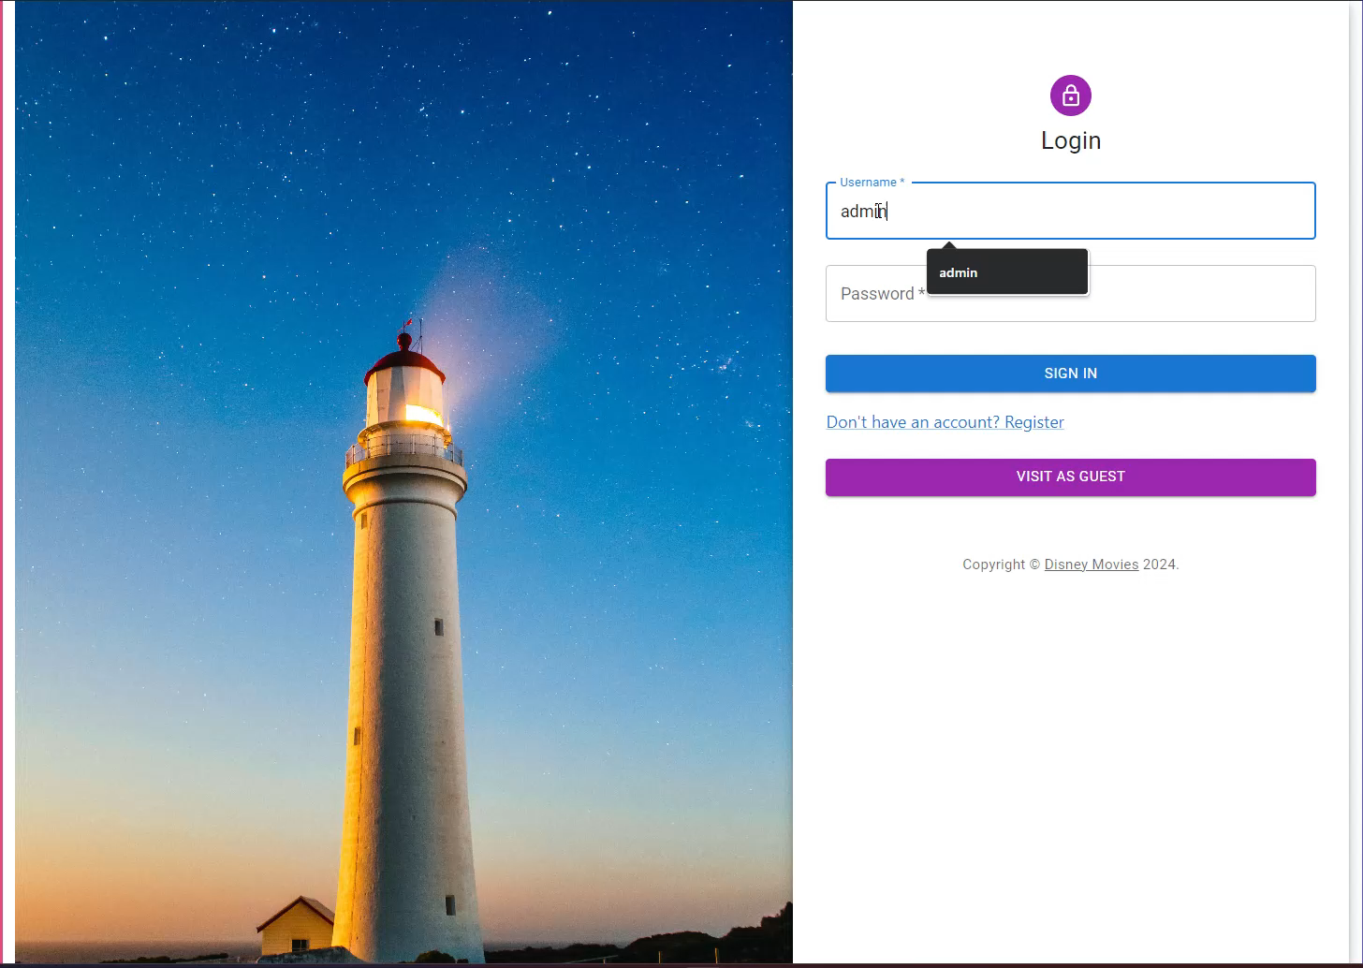
Admin see all users + remove them
Get Deep Search and recommendations by AI Keytalk

Slide 13
THANK YOU
Enache Vlad

